Slide 1

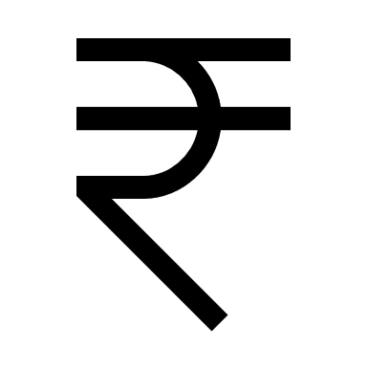
L.O.B
Laxman & Pranjali Nalawade

Slide 2

Vestige Pins are for Sale

Slide 3
Our Choice of Words
Go Crown
Go Fast start director
How to go Crown Director?
Which pin are you achieving this month?
Are you moving on?
Vs
How can I make 1 lakh/ month?
How can I make 25K/ 50K/ 75K per month?

Slide 4
Cheque
Two Factors determine our cheque
Volume – Turnover
Structure
Width will give you Profitability
Depth will give you stability & Profitability
Focus Core, Go Getter & Go Crown Club

Slide 5
3
STEPS TO
SUCCESS
1. CORE CLUB
2. GO GETTER CLUB
3. CROWN CLUB

Slide 6
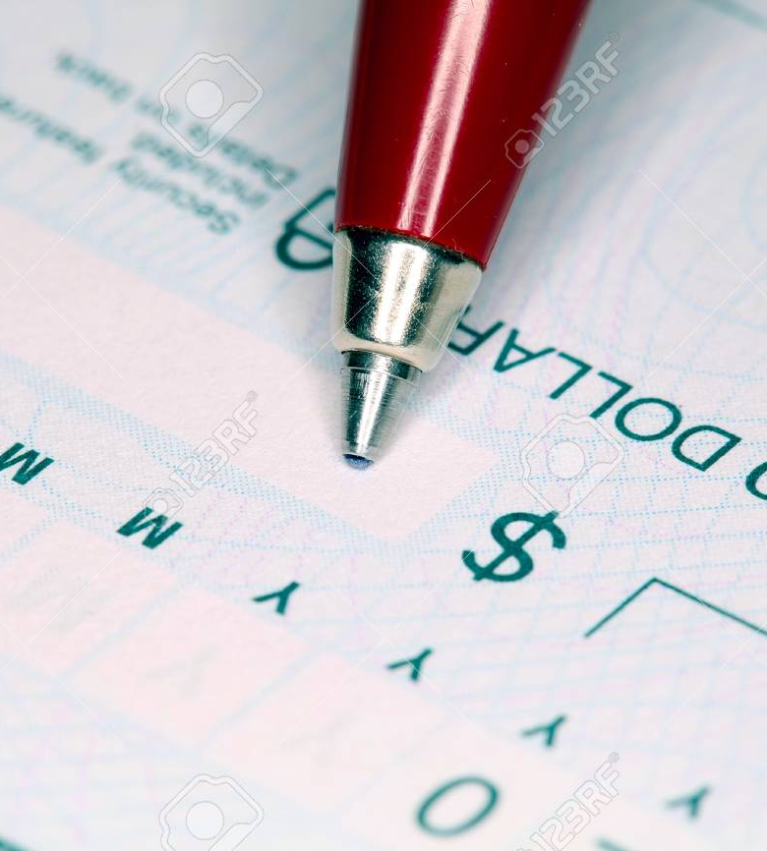

Focus
Pin
Income

Slide 7
Income Types
BBB
Travel Fund
Car Fund
House Fund
LOB
0.83
0.33
0.42
0.41
2.42

Slide 8
Income Types
Bonus
Value
LOB
Business Building Bonus
0.83
Travel Fund
0.33
Car Fund
0.42
House Fund
0.41
Total
1.99
House Fund
BBB
Leadership Bonus (LOB)
2.42
Car Fund

Slide 9
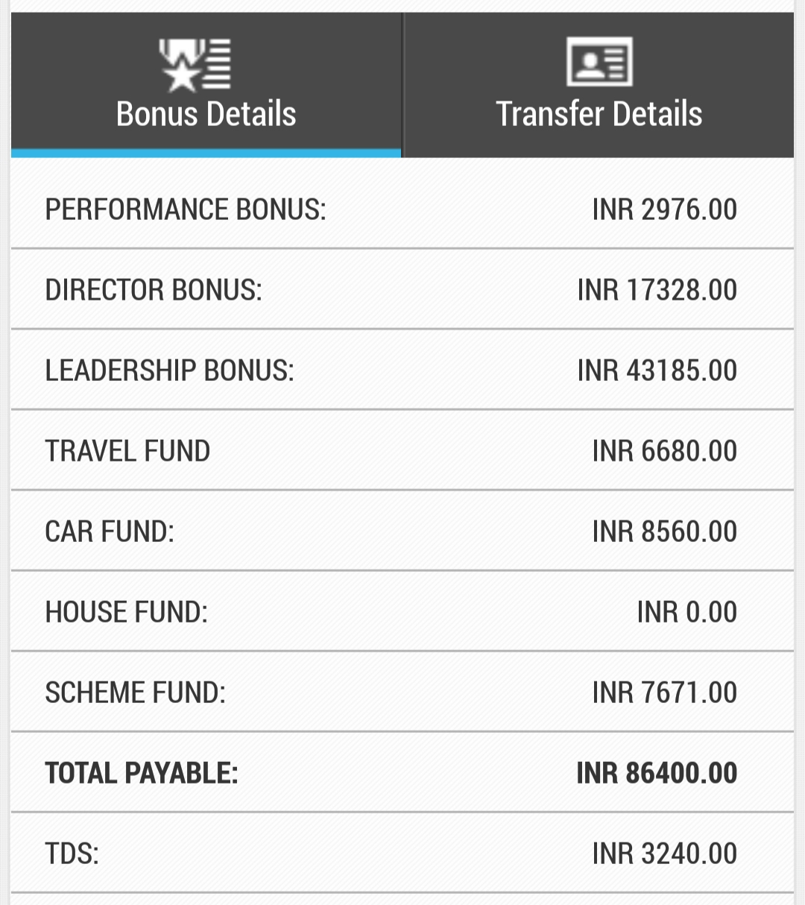
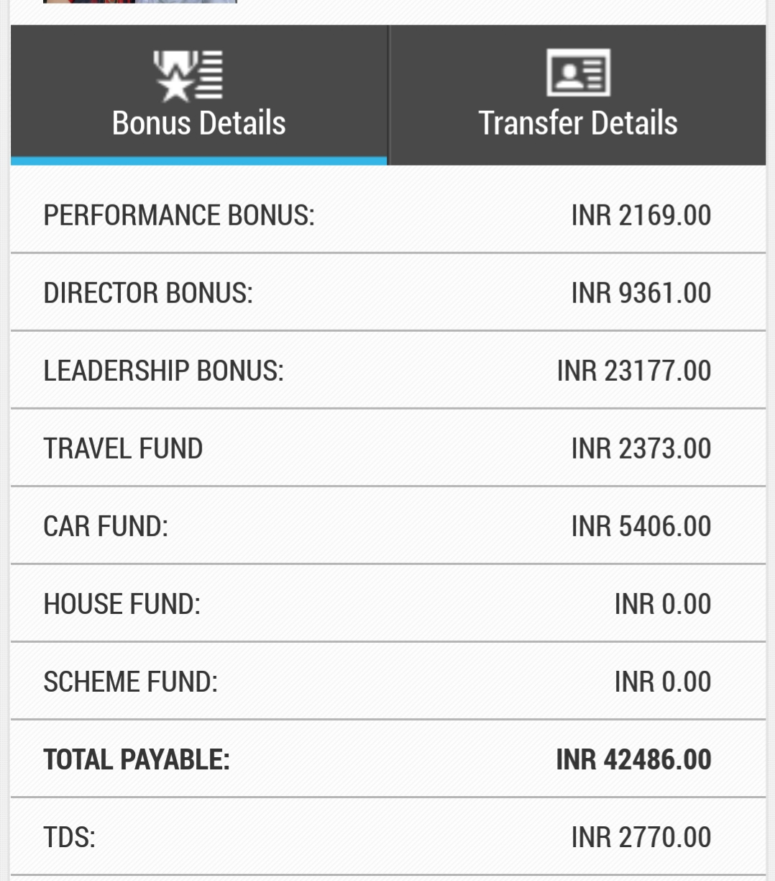
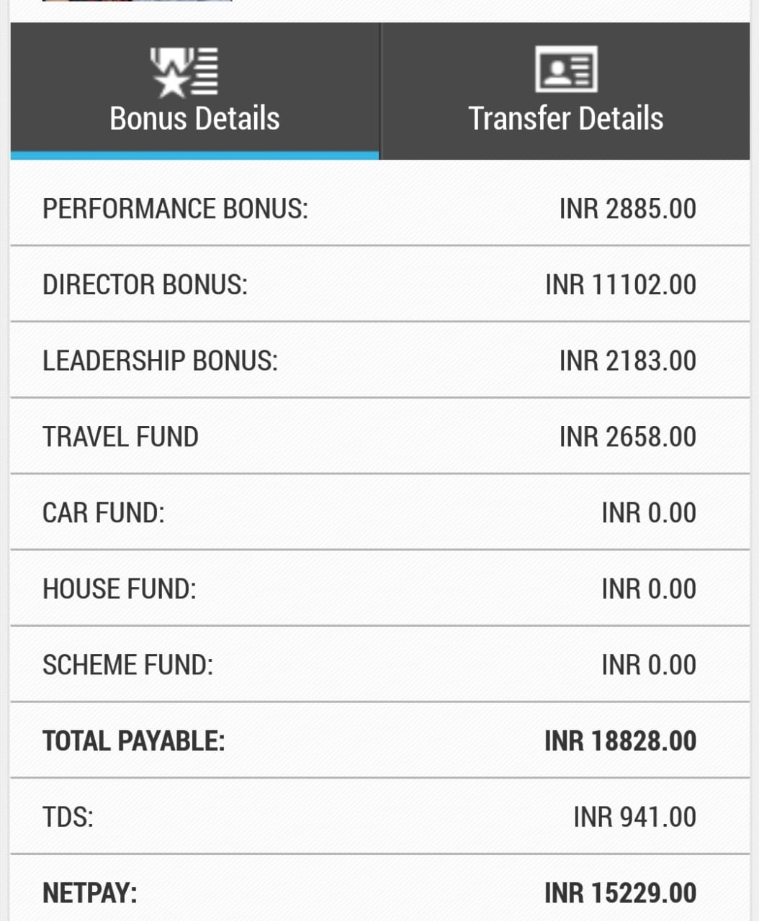
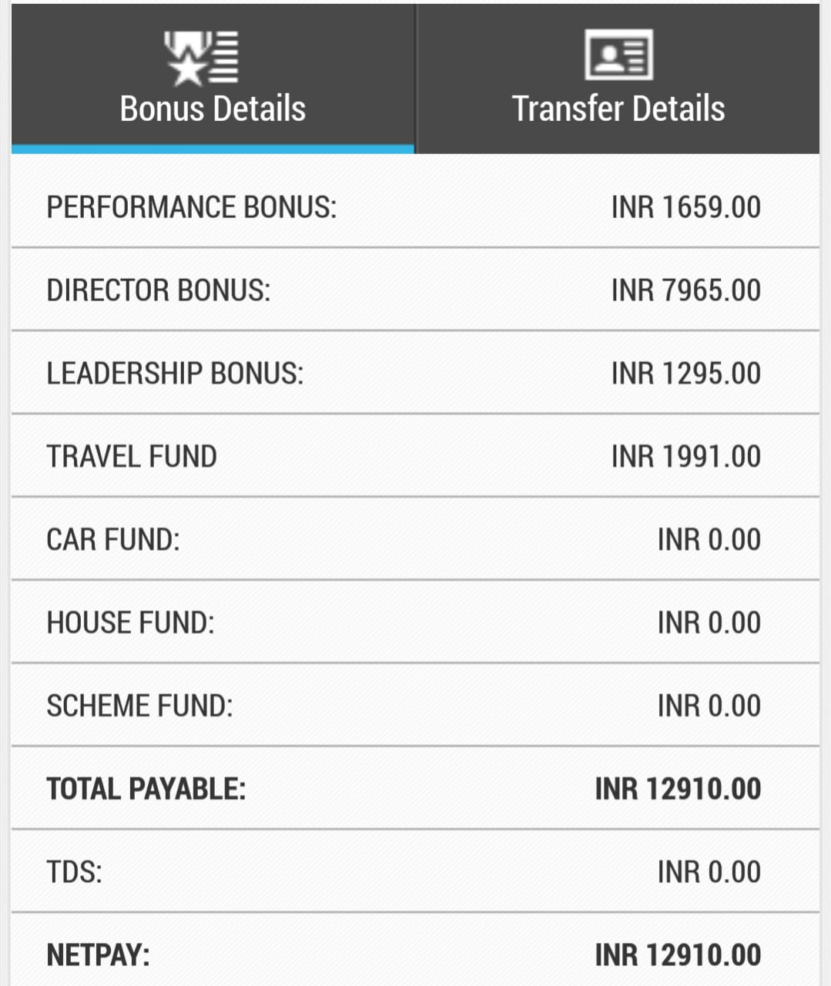
Case Study

Slide 10
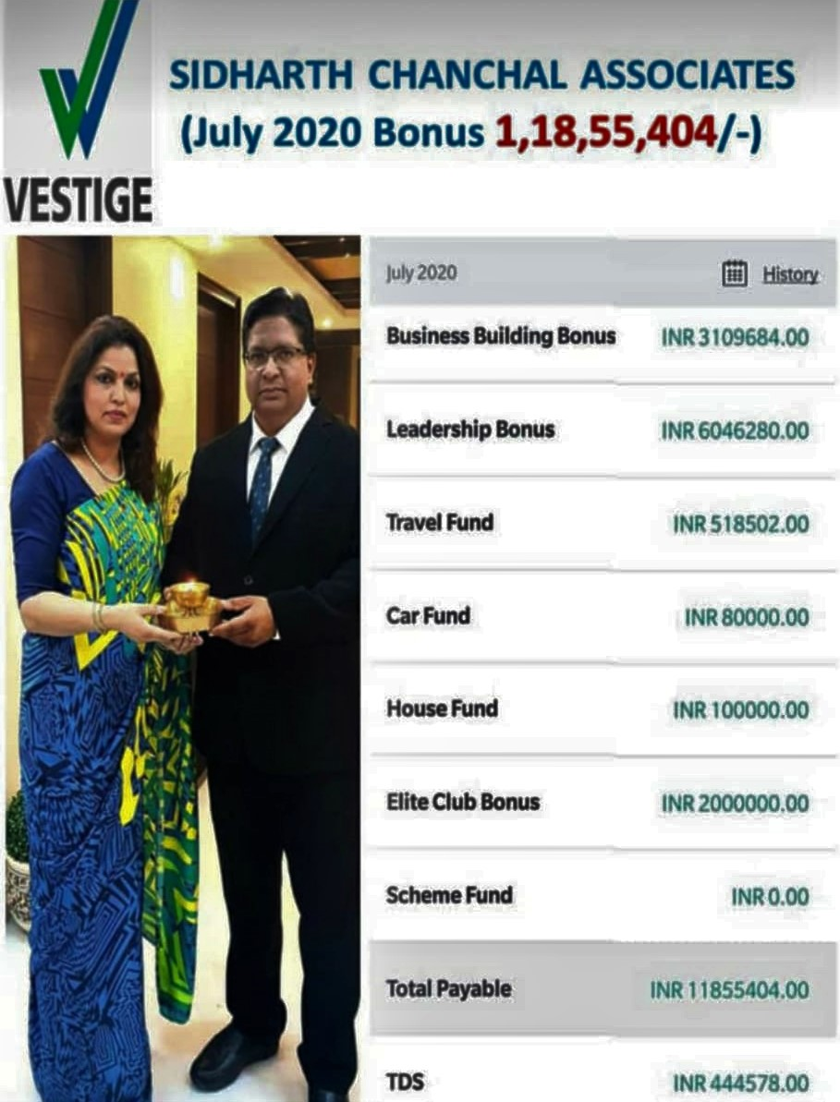
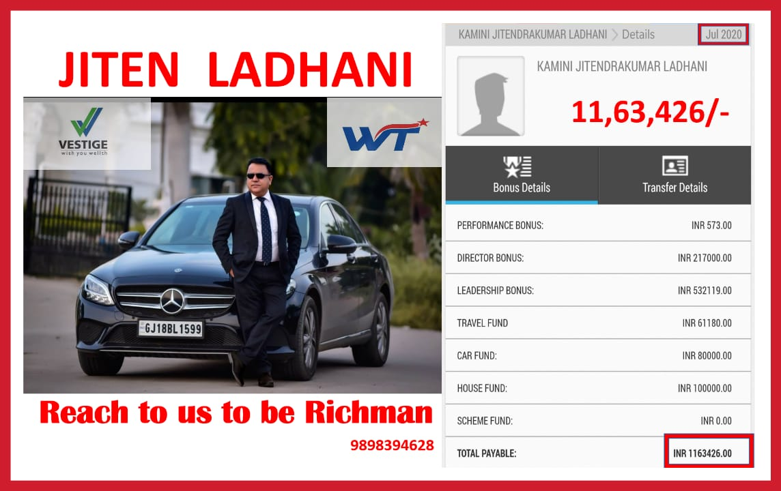

Slide 11
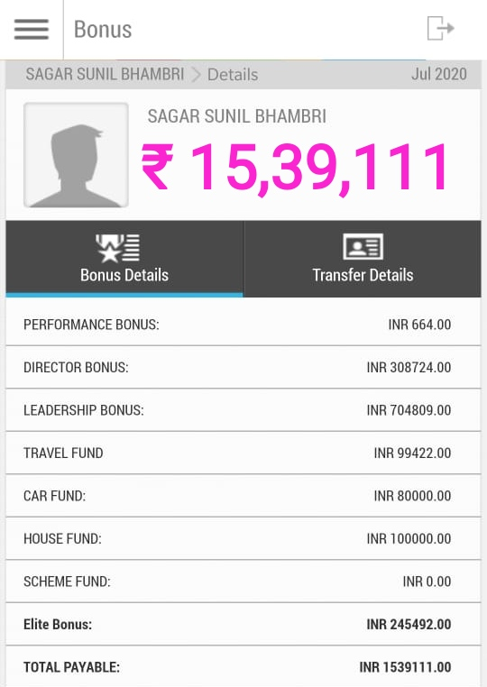

Slide 12
How to get LOB
First Create Environment of LOB in Team. Keep Speaking about it
Recognition – Recognize Income and not Pin.
Right Counselling & Constant follow up with downline
Depth Driving

Slide 13
A
DEPTH DRIVING
B
C
A is your leg
Help him go 4 wide. You do 4 basics.
    List, Call & Invite, STP & Joining
Find out who is excited; Suppose B. Do 4 Basics with B. Help him to go 4 wide
Find out C. Repeat
Find out D. Repeat.
Depth Never Stops
D
E

Slide 14
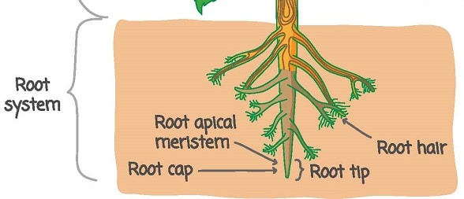
Work with the deepest point
Teach A,B,C, & D to duplicate you and work in their other legs
Involve them, Never go alone
Love uplines and work with downlines
Imp Question – Who is after me?
Biggest LOB at lowest Level
Strong Side Volume – 6000 PV

Slide 15
Mistakes in Depth Driving
Delegation of Depth
Not working on the creative end of the business (Root Cap)
Not promoting uplines to their downlines.
You need to be magic in your team till you go Director. After that you need to have a magician in every leg.
Getting comfortable with your immediate width / leader
Not making downline profitable
Plugging People in Big Meeting
Small Zoom Meetings will grow you business. Big meetings will maintain your business
Changing focus from leg that has momentum

Slide 16
Go LOB – Create LOB

Slide 17
Thank You

